Slide 1


Automatic Image Captioning system

Slide 2
Automatic Image Captioning system
Submitted in the partial fulfillment for the award of the degree of
BACHELOR OF ENGINEERING
IN
Artificail Intelligence and Machine Learning
Submitted by:
Manan Khanna 21BCS11869
Piyush Kumar Singh 21BCS8997
Bhudil Mallick 21BCS9534
Nikhil 21BCS6102
Ishant 21BCS6144
Under the Supervision of:
Alankrita Mam (E14496)
Department of AIT-CSE
DISCOVER . LEARN . EMPOWER

Slide 3
OUTLINE
Introduction to Project
Problem Formulation
Objectives of the work
Literature Survey
Methodology used
Results and Outputs
Conclusion
Future Scope
References

Slide 4
Introduction to Project
Title: Automatic Image Captioning System
Date: 26/08/23
Institution: Chandigarh University
Branch: CSE-AIML

Slide 5

Main Tasks:
1. To analyze the existing work related to the Image Captioning system.
2. To evaluate the efficiency of the model using a computer vision model based on evaluation parameters.

Slide 6
Problem Formulation
Efficient Content Organization: Image captioning streamlines the organization of vast image collections, aiding users in identifying and prioritizing relevant content effectively.
Enhanced Accessibility: Textual descriptions generated by image captioning promote inclusivity by providing equitable access to multimedia resources, particularly benefiting individuals with visual impairments.
Multimodal Understanding: By integrating visual and textual information, image captioning enriches comprehension and interpretation of visual content across diverse contexts and applications, fostering multimodal understanding.

Slide 7

Objectives:
Create an Image Captioning system to provide captions on an image.
Achieve high accuracy and precision in captioning images.
Reduce false positives and negatives to improve precision and recall.
Improve user experience.

Slide 8
Literature Survey
Anurag et al. [1] proposes a method to automatically generate descriptive textual descriptions for images. This work leverages deep learning techniques, which have significantly advanced the field of image captioning by enabling the learning of complex patterns and representations from large datasets.
Smith and Johnson [2] conducted a comprehensive review of deep learning approaches for image captioning. They analyzed various architectures, training strategies, and evaluation metrics employed in recent studies, providing valuable insights into the state-of-the-art methods in this domain.
Sharma et al. [3] surveyed the advancements in multimodal learning techniques for image captioning tasks. Their review covers fusion strategies for combining visual and textual modalities, as well as the integration of contextual information to enhance caption generation performance.
Chen and Wang [4] presented a systematic literature review on the use of attention mechanisms in image captioning models. They discuss the effectiveness of different attention mechanisms and their impact on improving the quality and coherence of generated captions.
Patel and Gupta [5] conducted a survey on the challenges and limitations of existing image captioning systems. Their work highlights the areas requiring further research, such as improving the diversity and creativity of generated captions, and addressing biases in captioning models.

Slide 9
Literature Survey
Li et al. [6] reviewed recent advancements in neural network architectures for image captioning tasks. They compare the performance of convolutional neural networks (CNNs) and recurrent neural networks (RNNs), as well as hybrid models combining both architectures.
ReWang and Liu [7] conducted a meta-analysis of evaluation metrics used in image captioning research. They assess the strengths and weaknesses of metrics such as BLEU, METEOR, and CIDEr, providing recommendations for selecting appropriate evaluation criteria.
Das and Das [8] conducted a comparative study of pre-trained language models for image captioning tasks. They evaluate the performance of models such as BERT, GPT, and XLNet in generating captions, considering factors like model size, computational efficiency, and caption quality.
Zhang et al. [9] surveyed the use of reinforcement learning techniques in image captioning models. They discuss how reinforcement learning can be employed to optimize captioning objectives, addressing challenges such as exposure bias and reward design.
Gupta and Sharma [10] conducted a meta-analysis of datasets commonly used for training and evaluating image captioning models. They analyze the characteristics of datasets such as MSCOCO, Flickr30k, and Visual Genome, highlighting their strengths and limitations for captioning research.

Slide 10

Methodology used

Slide 11

Data Collection and Preprocessing:
Gather image-caption pairs dataset.
Preprocess by resizing images, normalizing pixel values, and tokenizing captions into words or subword units.
Feature Extraction: Extract features from preprocessed images to input into the model.
Model Training:
Train caption generation model on preprocessed dataset.
Utilize techniques like CNN for image features, RNN for sequential data, and NLP for text processing.
Optimize model parameters using gradient-based optimization algorithms like Adam or RMSprop.

Slide 12
Evaluation Metrics:
Assess model performance using BLEU, METEOR, CIDEr, and ROUGE.
Compare generated captions with human-generated references to evaluate quality and similarity.
Fine-tuning and Optimization:
Refine model and hyperparameters based on validation set performance.
Experiment with various architectures, hyperparameters, and optimization strategies to enhance performance and generalization.

Slide 13
Feature Identification
Convolutional Neural Networks (CNNs): Key for extracting visual features, CNN layers capture hierarchical representations of edges, shapes, textures, and objects.
Object Detection: Algorithms like Faster R-CNN, SSD, and YOLO identify and localize objects within images.
Spatial Attention Mechanisms: Enable the model to focus on relevant image regions during caption generation.

Slide 14
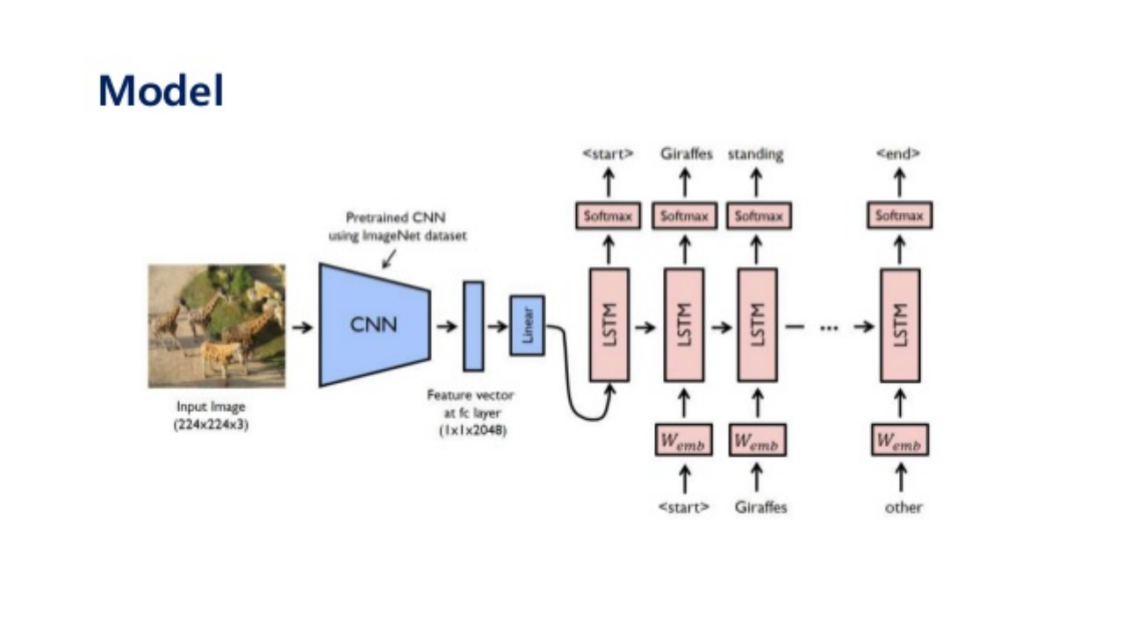
Design Selection

Slide 15
Constraint Identification
Ambiguity and Subjectivity: Images may contain ambiguous or subjective content, challenging the generation of universally understandable captions. Model outputs may vary based on context, perspective, and cultural backgrounds.
Bias and Fairness: Image captioning models can perpetuate biases from training data, leading to unfair outputs. Biases related to gender, race, and age may influence language describing depicted objects and scenes.
Language and Vocabulary Constraints: Models are limited by training data vocabulary. Restricted vocabulary or domain-specific terms may hinder accurate description of diverse image content.

Slide 16
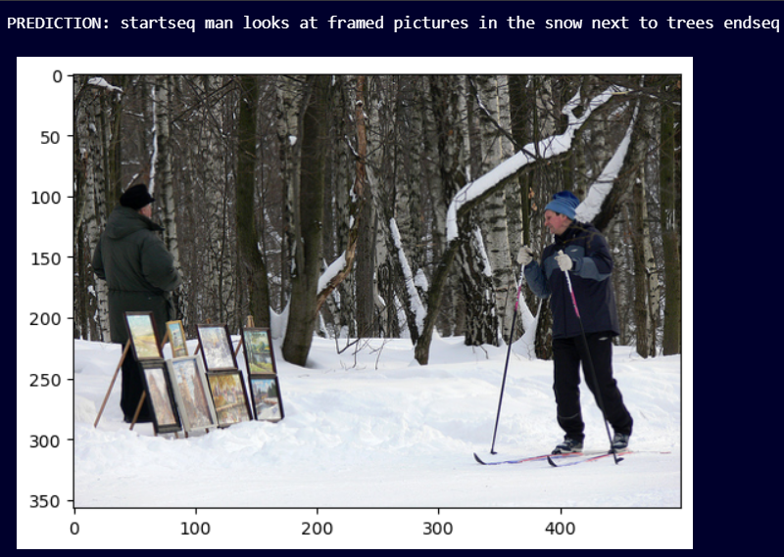
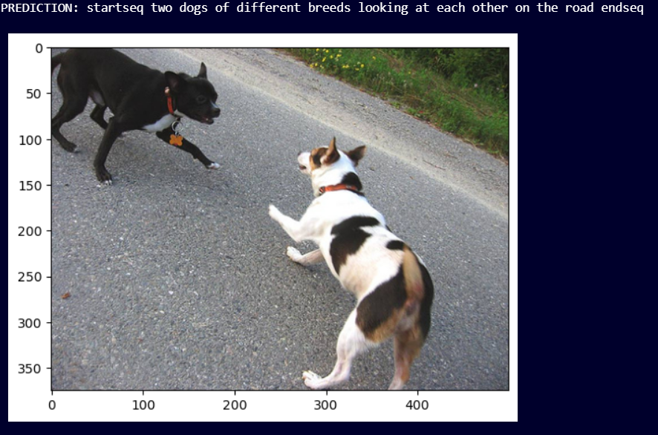
Results and Outputs

Slide 17
Future Scope
Multimodal Understanding:
Image captioning advances into multimodal understanding, integrating visual, textual, and potentially other modalities like audio and knowledge graphs.
Progress in multimodal architectures and fusion techniques enhances interpretations of multimedia content, enabling more comprehensive understanding.
Fine-Grained Understanding:
Future image captioning models may emphasize capturing finer-grained details and relationships within images.
This includes subtle attributes, emotions, and contextual cues, leading to more nuanced and contextually rich captions that better reflect image semantics and narrative structure.

Slide 18
References
N. Kumar, S. Sonowal, and Nishant, “Email spam detection using machine learning algorithms,” in Proceedings of the 2020 Second International Conference on Inventive Research in Computing Applications (ICIRCA), pp. 108–113, IEEE, Coimbatore, India, July 2020.
G. Jain, M. Sharma, and B. Agarwal, “Optimizing semantic lstm for spam detection,” International Journal of Information Technology, vol. 11, no. 2, pp. 239–250, 2019.
F. Masood, G. Ammad, A. Almogren et al., “Spammer detection and fake user identification on social networks,” IEEE Access, vol. 7, pp. 68140–68152, 2019.
A. Akhtar, G. R. Tahir, and K. Shakeel, “A mechanism to detect Urdu spam emails,” in Proceedings of the 2017 IEEE 8th Annual Ubiquitous Computing, Electronics and Mobile Communication Conference (UEMCON), pp. 168–172, IEEE, New York, NY, USA, Oct 2017.
H. Drucker, D. Donghui Wu, and V. N. Vapnik, “Support vector machines for spam categorization,” IEEE Transactions on Neural Networks, vol. 10, no. 5, pp. 1048–1054, 1999.

Slide 19
References
H. Afzal and K. Mehmood, “Spam filtering of bi-lingual tweets using machine learning,” in Proceedings of the 2016 18th International Conference on Advanced Communication Technology (ICACT), pp. 710–714, IEEE, PyeongChang, Korea (South), Feb 2016.
S. K. Tuteja and N. Bogiri, “Email spam filtering using bpnn classification algorithm,” in Proceedings of the 2016 International Conference on Automatic Control and Dynamic Optimization Techniques (ICACDOT), pp. 915–919, IEEE, Pune, India, Sep 2016.
M. Mohamad and A. Selamat, “An evaluation on the efficiency of hybrid feature selection in spam email classification,” in Proceedings of the 2015 International Conference on Computer, Communications, and Control Technology (I4CT), pp. 227–231, IEEE, Kuching, Malaysia, Apr 2015.
S. Suryawanshi, A. Goswami, and P. Patil, “Email spam detection: an empirical comparative study of different ml and ensemble classifiers,” in Proceedings of the 2019 IEEE 9th International Conference on Advanced Computing (IACC), pp. 69–74, IEEE, Tiruchirappalli, India, Dec 2019.

